Slide 1
PANDEMIC SITUATION OF COVID - 19

Slide 2
Agenda
MEET OUR TEAM 3
INTRODUCTION 4
PROJECT EXPLANATION 5
INSIGHTS 6
DASHBOARD 7

Slide 3




meet our team
Jigar Sanandiya
Vinod Patil​
Vaibhav Arora
Bushra Dosani
Visualization and SQL parts
Work on Create Dataset
Work on Cleaning part of the Dataset
Work on Joining Tables and SQL parts

Slide 4

Introduction
The COVID-19 pandemic, also known as the coronavirus pandemic, is an ongoing global pandemic of coronavirus disease 2019 (COVID-19) caused by severe acute respiratory syndrome coronavirus 2 (SARS-CoV-2)
The first known case was identified in Wuhan, China, in December 2019. The disease quickly spread worldwide, resulting in the COVID-19 pandemic.
The symptoms of COVID‑19 are variable but often include fever, cough, headache, fatigue, breathing difficulties, loss of smell, and loss of taste
Link:-
https://en.wikipedia.org/wiki/COVID-19
COVID-19 (disease)
SARS-CoV-2 (virus)

Slide 5
Project Explanation
Extracting data from nested JSON using the request module and List comprehension.
Using the python library to create Data Frame
Converting Data Frames to CSV files.
Cleaning the data using python and analyzing data using SQL.
Worked on data for Insights and visualizing using Excel.
Create dashboard

Slide 6
Insights
Number of Covid19 Deceased cases suddenly raised during 2021 as compared to 2020
The number of deceased cases was much more severe in the TT State
While scraping the data we found that the test ratio is maximum in Chandigarh(0.7512) and Urban Bangalore(0.7179) compared to other districts.
Number of confirmed cases does not depend on the number of testing.
Vaccination start in January 2021 and Vaccination effect on Recovery cases

Slide 7
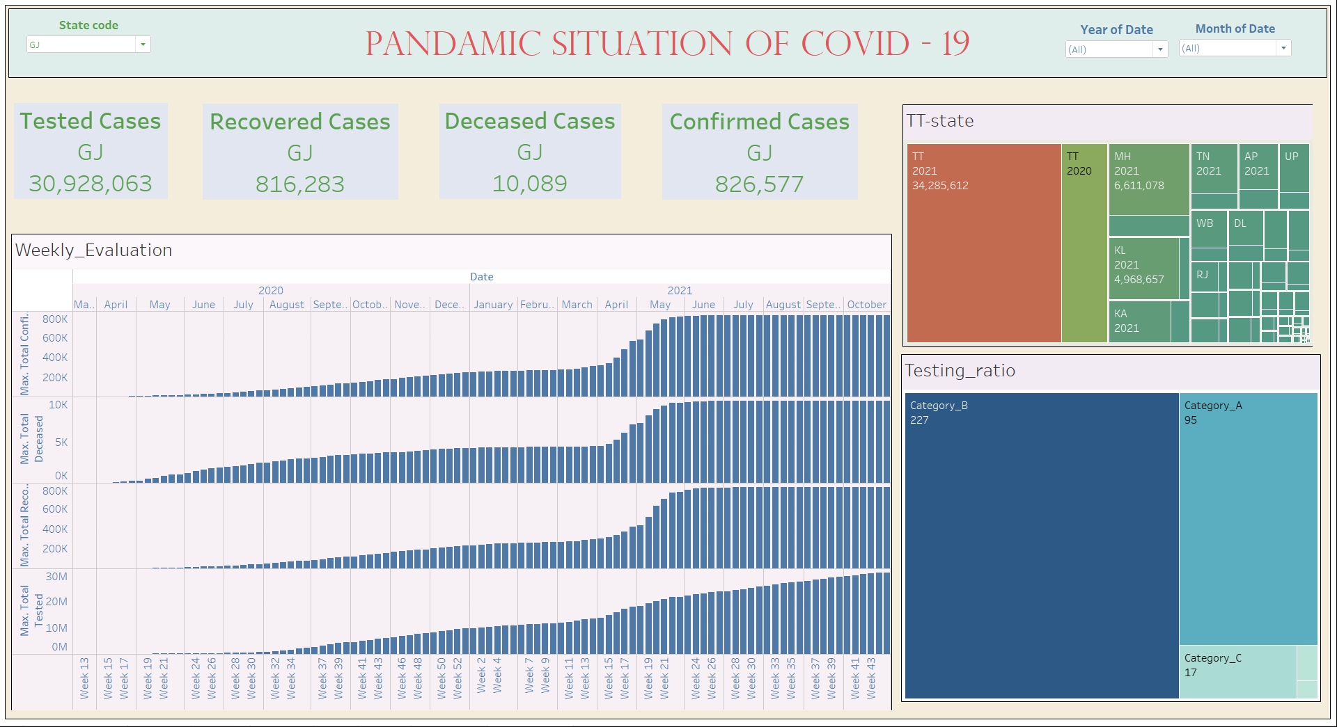

Slide 8
Thank you

